Slide 1
Java Programming
Introduction
J. Bhavithra
Assistant Professor(Senior Scale)/ CSE

Slide 2

Java Programming
Designed by James Gosling
Developed by Oracle Corporation
1995 Language
Initially called as “Oak”
  After an oak tree that stood outside Gosling's office
  Later the project went by the name Green and was finally renamed Java, from Java coffee

Slide 3
Java Programming
Java is a general-purpose programming language that is class-based, object-oriented and Platform independent. It is intended to let application developers Write Once, Run Anywhere (WORA)

Slide 4
Platform Independent
Compiling a Java Program
MAC based JVM
Output
Windows
source.java
Java Interpreter
(JVM)
Java Virtual Machine
source.class
Output
Java Compiler
Linux based JVM
Output

Slide 5
Object Orientation
A problem-solving method in which the software solution reflects objects in the real world.
Each object comprising of:
Properties (Attributes)
Functions (Methods)

Slide 6



Class and Object
Real World Examples
Objects
Truck
Car
Bus
Vehicle/ Automotive/etc..,
Class

Slide 7
Properties and Functions
Object | Properties | Functions
 | Color Vehicle Number No. of Seats Load Capacity Model Number | Carry load Start engine Stop engine Load fuel Display meter
 | Color Vehicle Number No. of Seats Load Capacity Model Number | Carry load Start engine Stop engine Load fuel Display meter
 | Color Vehicle Number No. of Seats Load Capacity Model Number | Carry load Start engine Stop engine Load fuel Display meter

Slide 8
Class and Object In Program
Class Vehicle
{
String color;
int vehicle_number; no_of_Seats; load_capacity; model_number;
void start_engine( )
{….}
void stop_engine( )
{….}
}
Vehicle lorry = new Vehicle();
Vehicle car = new Vehicle();
Vehicle bus = new Vehicle();

Slide 9
Class and Object In Program
Class Student
{
String name;
int roll_num; mark1, mark2, mark3;
void get_details( )
{….}
void display_details( )
{….}
}
Student 18BCS002 = new Student();
Student 18BCS004 = new Student();
Student 18BCS008 = new Student();

Slide 10
3 Versions
J2SE – Java as Standard Edition (for desktop stand alone applications)
J2EE – Java as Enterprise Edition (for client-server based application)
J2ME – Java as Micro Edition (for Mobile based application)

Slide 11
C Program to print “My India”
Java Program to print “My India”
#include <stdio.h>
int main()
{
printf(“My India!");
return 0;
}
public class myIndia
{
public static void main(String[] args)
{
System.out.println(“My India");
}
}
Save the program as “myIndia.java”

Slide 12
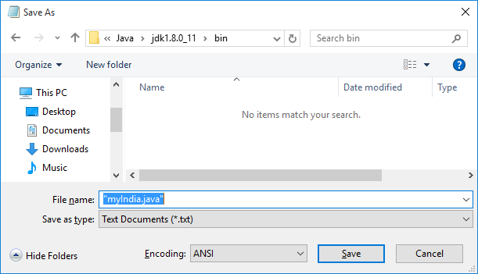
How to Compile and Run
Open Notepad and type the program
Save as “myIndia.java” inside Java’s Bin directory
C:\Program Files\Java\jdk1.8.0_11\bin

Slide 13
How to Compile and Run
Open command prompt ( + R)
Type “cmd”
Navigate to the path: C:\Program Files\Java\jdk1.8.0_11\bin
Compile the program as > javac myIndia.java
Run as > java myIndia
Programs saved in other locations
Open cmd and navigate to program location
Type: set path = “C:\Program Files\Java\jdk1.8.0_11\bin”

Slide 14
Program using command prompt
public class myIndia
{
public static void main(String[] args)
{
System.out.println(“Argument 1:”+ args[0]);
System.out.println(“Argument 2:”+ args[1]);
System.out.println(“Argument 3:”+ args[2]);
}
}

Slide 15
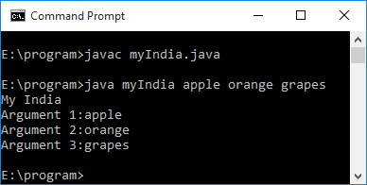
Program using command prompt

Slide 16
Reading Input
import java.util.Scanner;
public class sample {
public static void main(String[] args) {
Scanner scan = new Scanner(System.in);
System.out.println("Enter any String: ");
String s; int num; float f;
s=scan.nextLine();
System.out.print("Enter any number: ");
num = scan.nextInt();
System.out.println("Enter any float number: ");
float f=scan.nextFloat();
scan.close();
System.out.println("The number entered by user: "+num+"\t"+f+"\t"+s);
} }

Slide 17
Difference between C and Java
C Language
Java Language
C is a Procedural Programming Language
Platform dependent
Does not support Inheritance, Polymorphism, Abstraction and Encapsulation.
Does not supports Threading and exception handling
Function overloading/ Overriding is not supported
Default members of C are public.
Java is Object-Oriented language
Platform Independent
Support Inheritance, Polymorphism, Abstraction and Encapsulation.
Supports Threading and exception handling
Function overloading/ Overriding is supported
Default members of Java are private.

Slide 18
Advantages of Java
Simplifies web programming
Applet
  A special kind of java program that is designed to be transmitted over Internet and executed by browser
Security
  Java is a secured language
Portability
  Processor, OS and Browser independent

Slide 19
Properties of Java
Simple
  Easily designed for a programmer to learn and use
Object Oriented
Robust
  Errors and exceptions are checked during early stages of program development (Compile time and Runtime)
Multithreaded
  Ability to run multiple program simultaneously

Slide 20
Properties of Java…
Architectural Neutral
  WORA (Write Once and Run Anywhere)
Interpreted and high performance
  Generation of Byte code:
    Highly optimized set of instructions designed from source code & executed by Java Virtual Machine (JVM)
  Hence achieving high performance

Slide 21
Properties of Java…
Distributed
  Apt for distributed environment
  Supports Remote Method Invocation (RMI) – calling a method in some other remote machine
Dynamic
  Dynamically linking the code in a safe and expedient manner

Slide 22
Object Oriented Principles
Abstraction
Encapsulation
Inheritance
Polymorphism

Slide 23
Abstraction
Abstraction is defined as the process of identifying only the required characteristics of an object ignoring the irrelevant details

Slide 24
Abstraction
Abstraction is defined as the process of identifying only the required characteristics of an object ignoring the irrelevant details
E.g.., Student Mark Management System
  Required properties and functions
    Properties: Roll_num, Name, class, semester, courses, marks
    Functions: get_details( ), process( ), display_details( )
  Unnecessary properties and functions
    Height, weight, color, age, play_game( ), drive( )

Slide 25
Encapsulation
Also called as Data Hiding. A mechanism that binds together code and the data it manipulates. Prevents the data from being accessed by the code outside this shield.

Slide 26
Encapsulation
class Sample
{
int a, b;
void change(int i)
{
a=a+b+i;
SOP (a);
}
}
Sample s1, s2;
s1.a=10;
s1.b=20;
s1.change(10);
s2.a=30;
s2.b=40;
s2.change(20);

Slide 27
Inheritance
It is the mechanism in java by which one class is allow to inherit the features(properties and methods) of another class.

Slide 28
Inheritance
It is the mechanism in java by which one class is allow to inherit the features(properties and methods) of another class.
Sample
<a,b, change()>
No change in Sample
Sub_Sample can access
a, b, c, d, change( ) and process( )
Sub_Sample
<c,d, process( )>

Slide 29
Polymorphism
Poly + Morphs (Many forms)
Same function name, but multiple actions
Code reusability
Reduces complexity

Slide 30
Polymorphism
Poly + Morphs (Many forms)
Same function name, but multiple actions
Code reusability
Reduces complexity
void get()
{
Stud_name=scan.nextLine();
Stud_roll = scan.nextInt();
}
void get()
{
emp_name=scan.nextLine();
emp_id = scan.nextInt();
}

Slide 31
Thank You

